Slide 1
Object-Oriented Programming Concepts
Review

Slide 2
Contents
1. What is OOP?
2. Classes and Objects
3. Principles of OOP
• Inheritance
• Abstraction
• Encapsulation
• Polymorphism

Slide 3
What is OOP?
Object-oriented programming (OOP) is an engineering approach for building software systems
Based on the concepts of classes and objects that are used for modeling the real world entities
Object-oriented programs
Consist of a group of cooperating objects
Objects exchange messages, for the purpose of achieving a common ob4jective
Implemented in object-oriented languages

Slide 4
OOP in a Nutshell •
A program models a world of interacting objects
Objects create other objects and “send messages” to each other (in Java, call each other’s methods)
Programmers write classes (and reuse existing classes)
Each object belongs to a class
A class defines properties of its objects
The data type of an object is its class

Slide 5
What are OOP’s Claims To Fame?
Better suited for team development
Facilitates utilizing and creating reusable software components
Easier GUI programming
Easier software maintenance
All modern languages are object-oriented: Java, C#, PHP, Perl, C++, ...

Slide 6
What Are Objects?
Software objects model real-world objects or abstract concepts
E.g. dog, bicycle, queue
Real-world objects have states and behaviors
Dogs' states: name, color, breed, hungry
Dogs' behaviors: barking, fetching, sleeping

Slide 7
What Are Objects?
How do software objects implement real- world objects?
Use variables/data to implement states
Use methods/functions to implement behaviors
An object is a software bundle of variables and related methods

Slide 8
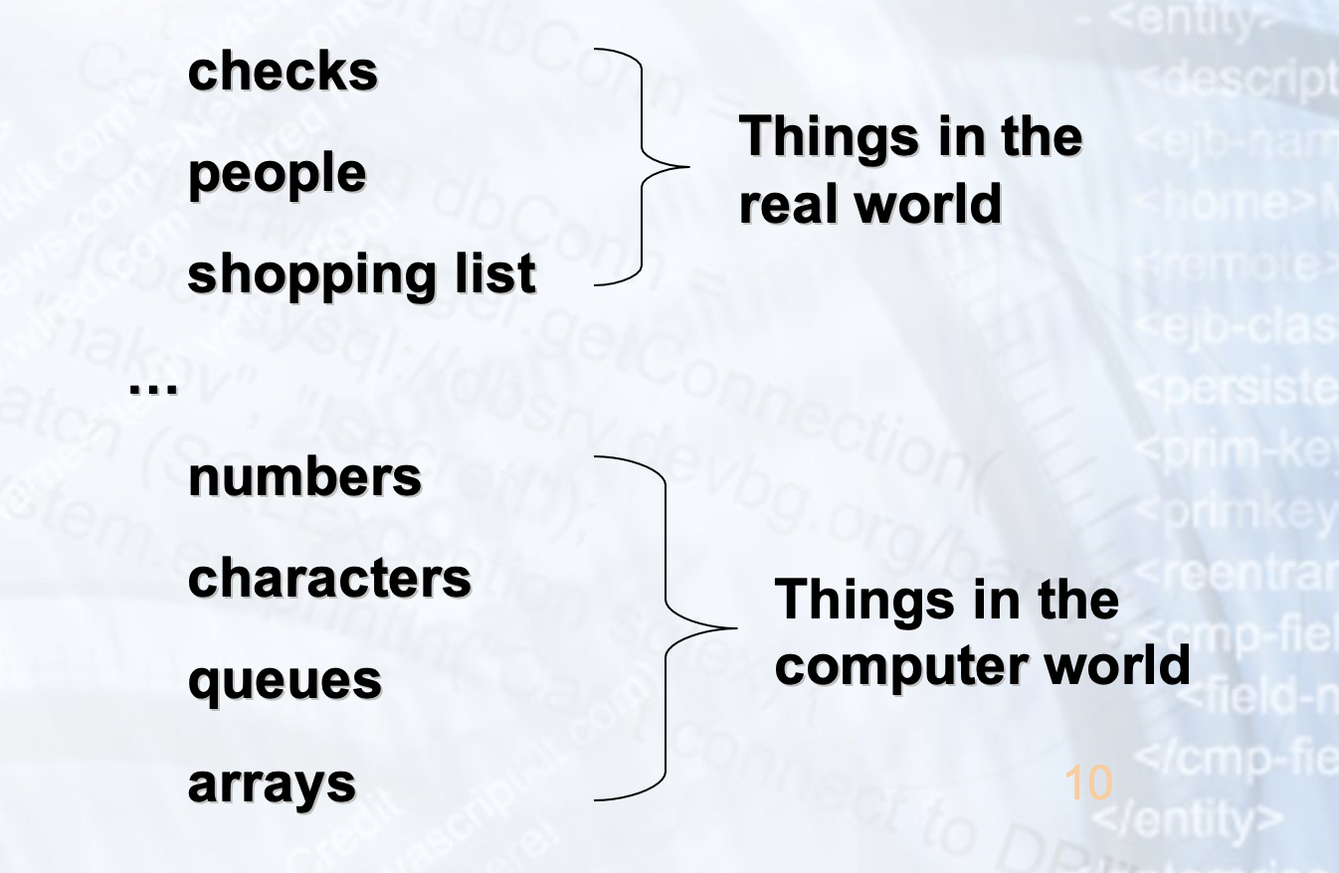
Objects Represent

Slide 9
Classes
Classes provide the structure for objects
Define their prototype
Classes define:
Set of attributes
Also called state
Represented by variables and properties
Behavior
Represented by methods
A class defines the methods and types of data associated with an object

Slide 10
Objects
Creating an object from a class is called
instantiation
An object is a concrete instance of a particular class
Objects have state
Set of values associated to their attributes
Example:
Class: Account
Objects: Ivan's account, Peter's account

Slide 11
Classes and Objects –Example
Object
ivanAccount
Cllass
+Owner="Ivan Kollev"
+Ammount=5000.0
Account
+Owner: Person
+Ammount: double
Objject
peterAccount
+suspend(()
+deposit(sum:double)
+withdraw(sum:double)
+Owner="Peter Kirov"
+Ammountt=1825.33
kirilAccount
Objject
+Owner="Kiril Kirov"
+Ammount=1245.0

Slide 12
Classes - Example
Class
Attttributes
Account
+Owner: Person
+Ammountt: double
+suspend()
+deposit(sum:double)
+withdrraw(sum:double)
Operattiions

Slide 13
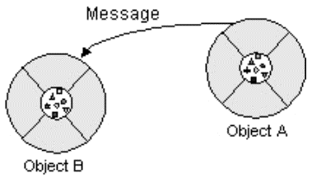
Messages
What is a message in OOP?
A request for an object to perform one of its operations
(methods)
All communication between objects is done via
messages

Slide 14
Interfaces
Messages define the interface to the object
Everything an object can do is represented by its message interface
The interfaces provide abstractions
You shouldn't have to know anything about what is in the implementation in order to use it (black box)
An interface is a set of operations (methods) that given object can perform

Slide 15
The Principles of OOP
Inheritance
Abstraction
Encapsulation
Polymorphism

Slide 16
Inheritance
A class can extend another class, inheriting all its data members and methods
The child class can redefine some of the parent class's members and methods and/or add its own
A class can implement an interface, implementing all the specified methods
Inheritance implements the “is a” relationship between objects

Slide 17
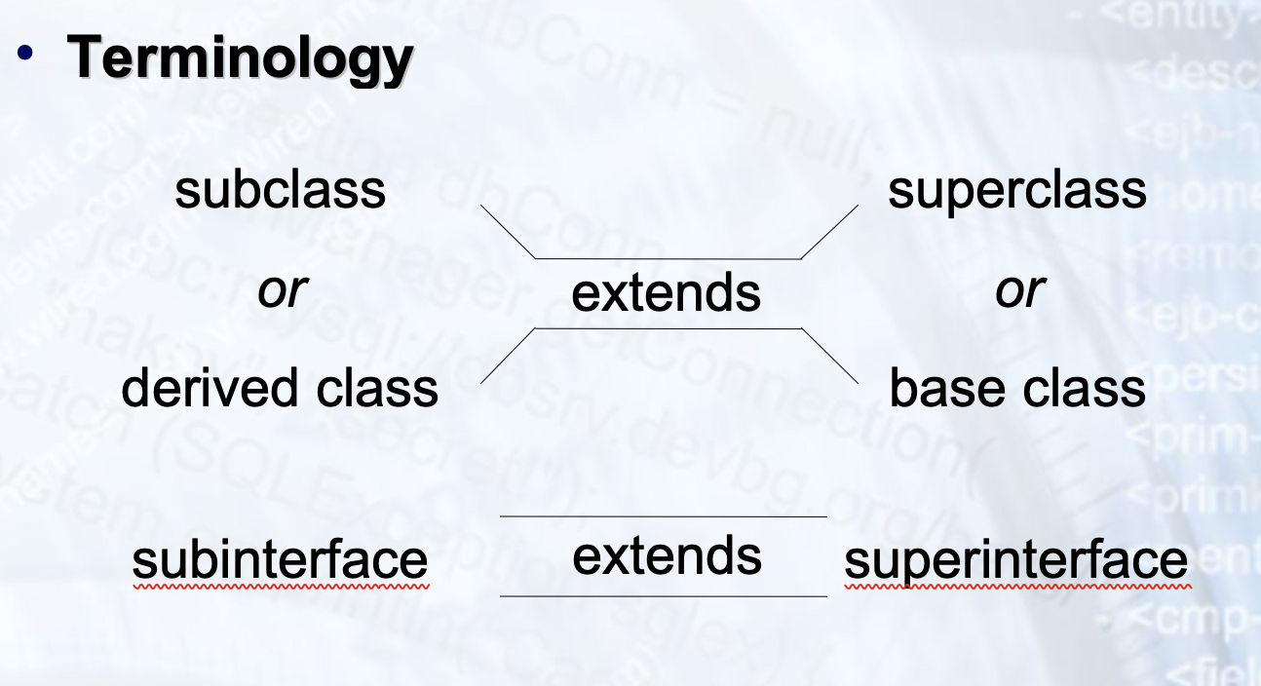
Inheritance

Slide 18
Inheritance
Superclass
`
Person
+Name: Sttrriing
+Address: String
Subclass
Subclass
Employee
+Company: String
+Sallarry: double
Student
+Schooll:: String

Slide 19
Inheritance Benefits
Inheritance plays a dual role:
A subclass reuses the code from the superclass
A subclass inherits the data type of the superclass (or interface) as its own secondary type

Slide 20

Abstraction
Abstraction means ignoring irrelevant features, properties, or functions and emphasizing the relevant ones...
... relevant to the given project (with an eye to future reuse in similar projects)
Abstraction = managing complexity
“Relevant” to what?

Slide 21
Abstraction
Abstraction is something we do every day
Looking at an object, we see those things about it that have meaning to us
We abstract the properties of the object, and keep only what we need
Allows us to represent a complex reality in terms of a simplified model
Abstraction highlights the properties of an entity that we are most interested in and hides the others

Slide 22
Abstract Data Type
Abstract Data Types (ADT) are data types defined by a set of operations
Examples:

Slide 23
Abstraction in AWT/Swing
java.lang.Object
|
+--java.awt.Component
|
+--java.awt.Container
|
+--javax.swing.JComponent
|
• +--javax.swing.AbstractButton

Slide 24
Encapsulation
Encapsulation means that all data members (fields) of a class are declared private
Some methods may be private, too
The class interacts with other classes (called the clients of this class) only through the class’s constructors and public methods
Constructors and public methods of a class serve as the interface to class’s clients

Slide 25
Encapsulation
Ensures that structural changes remain
local:
Usually, the internal structure of a class changes more often than the class’s constructors and methods
Encapsulation ensures that when fields change, no changes are needed in other classes (a principle known as “locality”)
Hiding implementation details reduces complexity → easier maintenance

Slide 26
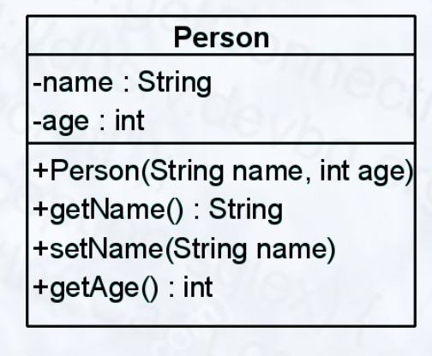
Encapsulation – Example
Data Fields are private
Constructors and accessor methods are defined

Slide 27
Polymorphism
Ability to take more than one form
A class can be used through its parent class's interface
A subclass may override the implementation of an operation it inherits from a superclass (late binding)
Polymorphism allows abstract operations to be defined and used
Abstract operations are defined in the base class's interface and implemented i3n5the subclasses

Slide 28
Polymorphism
Why use an object as a more generic type?
To perform abstract operations
To mix different related types in the same collection
To pass it to a method that expects a parameter of a more generic type
To declare a more generic field (especially in an abstract class) which will be initialized and “specialized” later

Slide 29
Polymorphism – Example
Abstract class
Abstract action
`
Concrete class
Overriden action
Overriden action
Square::calcSurface() { return size * size;
}
Circle::calcSurface() { return PI * radius *
raduis;
}

Slide 30
Polymorphism
Polymorphism ensures that the appropriate method is called for an object of a specific type when the object is disguised as a more generic type:
// This will call Square::calcSurface() int surface = f1.calcSurface()
// This will call Square::calcSurface() int surface = f2.calcSurface()
Figure | f1 | = | new | Square(...);
Figure | f2 | = | new | Circle(...);

Slide 31
OOPs
Questions?

Slide 32
Problems
Describe the term object in OOP. Describe the term class in OOP. Describe the term interface in OOP. Describe the term inheritance in OOP. Describe the term abstraction in OOP. Describe the term encapsulation in OOP. Describe the term polymorphism in OOP

